Slide 1
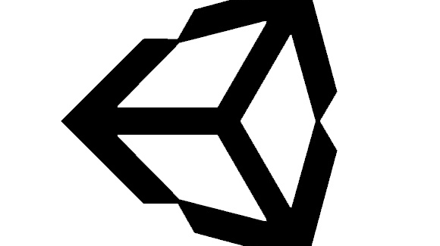
Intro to VR – Scripting 1
By: Jeremy Nielson

Slide 2
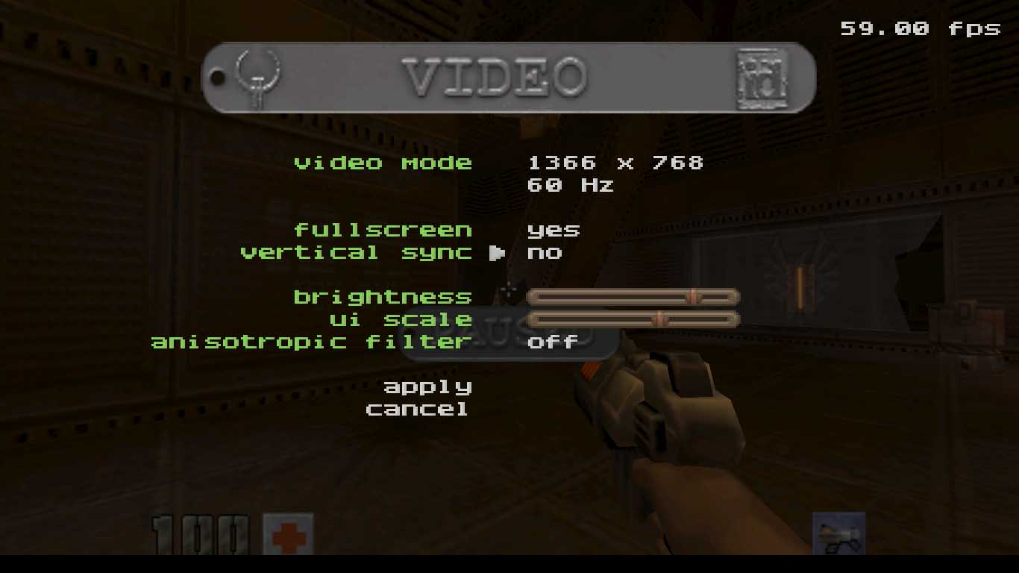
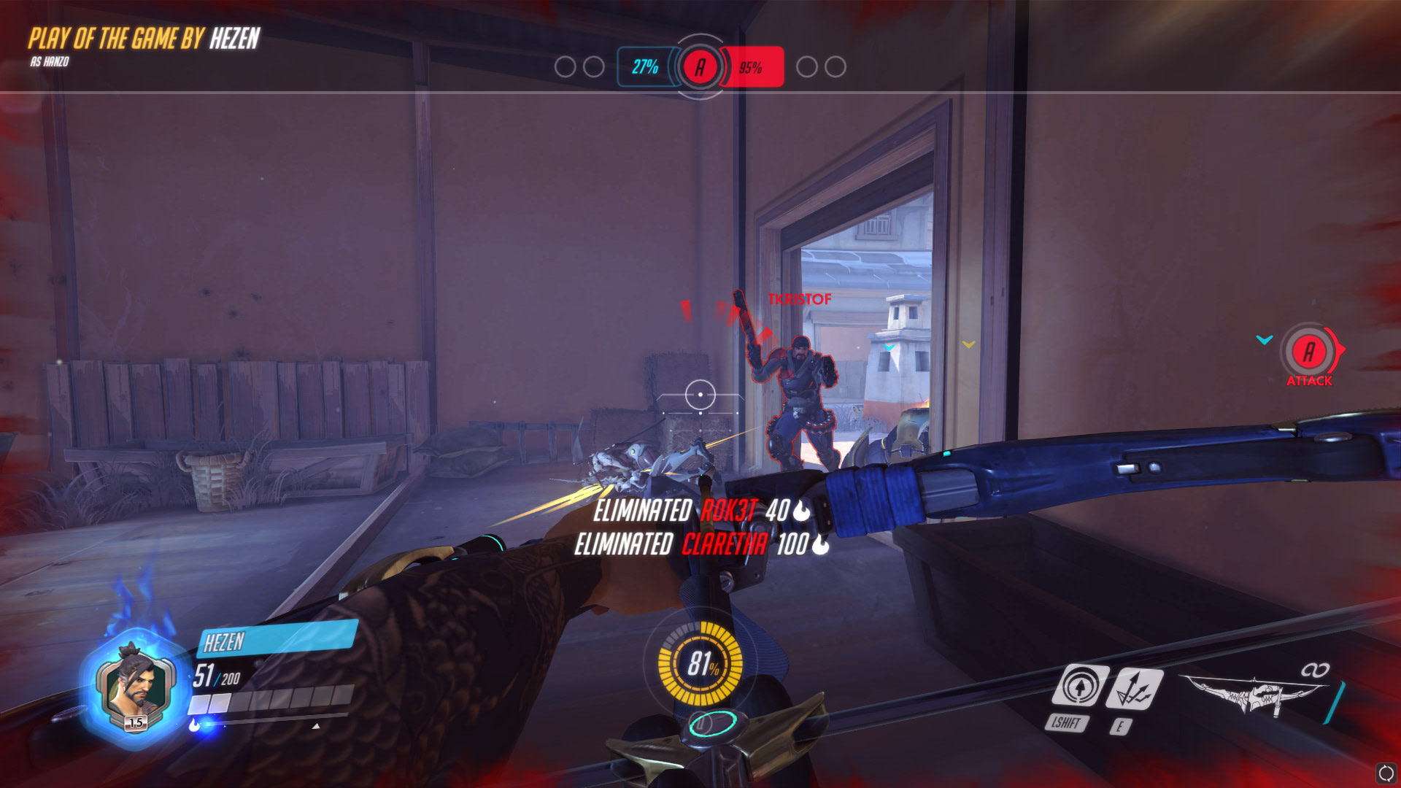
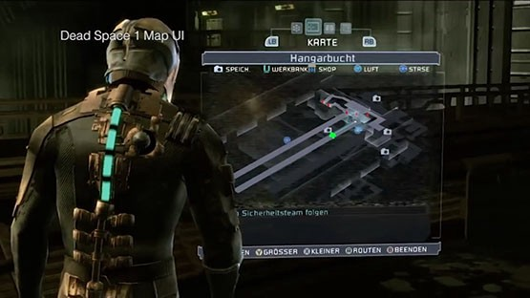
UI: VR Design vs. Standard UI
Typically, user interface both in game and in menus are generally aided in that the screen remains stationary and the user has mouse control in menus.
A lot of these elements can be translated into VR fairly well, but since the user interaction differs greatly from a standard controller, we need to be a bit more creative with how the user can interface with the world.

Slide 3
A Quick Note Regarding VR Plugins
Since the VR landscape is changing everyday, be prepared for any new updates to potentially put specific scripts and prefabs into OBSELECENCE.
In the case of this tutorial, there are scripts that SteamVR once had to create simple UI interaction with laser pointers, but due to inefficiency and hard coding, it was replaced by a new system.
We will be creating our own C# scripts to create a similar system with better usability and customizability
*This will be a lengthy tutorial as we are building the mechanics behind a menu system for the game.

Slide 4
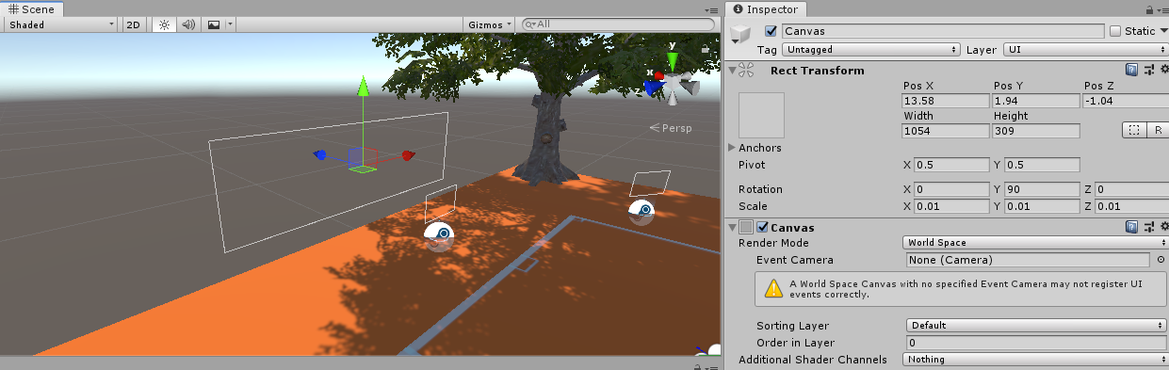
Creating a menu
Go ahead and create a new GameObject > UI > Canvas. You should immediately notice it is gigantic.
Start by changing the Render Mode for Canvas in Inspector to World Space.
Change the size to 0.01 for X, Y, Z.
Move the canvas into the play area somewhere that makes sense (ie. Not in teleporting space)

Slide 5
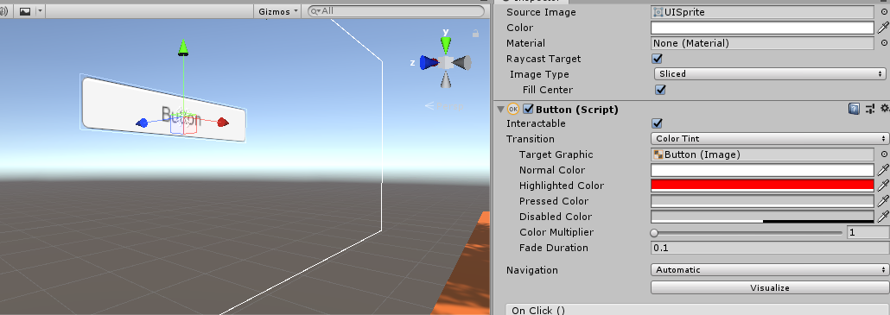
Creating a Button
Go ahead and right click your canvas object and create another UI object > Button.
For testing purposes, go ahead in the inspector panel under Button Script and change the highlight color to something drastically different

Slide 6
Getting Ready for C# Scripts
Create a Scripts folder inside of Assets. Right-click and Create two new C# Scripts:
Pointer + VRInputModule
Additionally, Create a new empty GameObject.
Drag and Drop the Pointer script in the Inspector Panel
Rename GameObject to “VRPointer”
Create a Prefab folder in Assets, Drag and Drop VRPointer into it
Add both Camera and Line components to VRPointer.
At this point, make sure that VRPointer is at Position 0,0,0 so you know where it is in scene

Slide 7
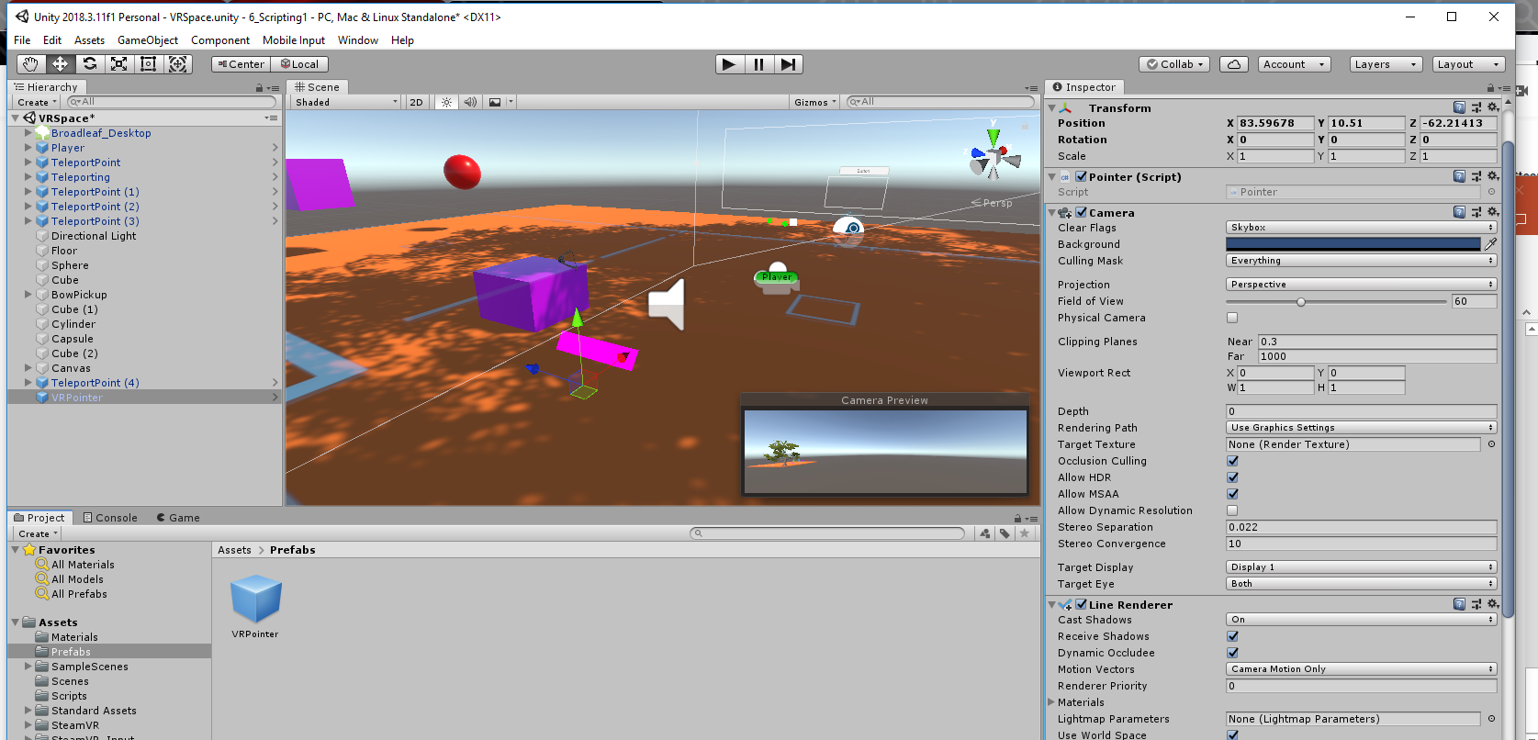
Progress So Far…

Slide 8
Camera and LineRender
The camera is going to be used to detect what exactly our controller is pointing at, whereas the Line Render will act as a visual guide to what our controller is specifically pointing at.
For now, please mirror the inspector panels shown on the following slide.
These settings will ensure that the second camera will not cause performance impact by disabling the render, create a line that tappers off, and disables any sort of shadow casting of the line

Slide 9
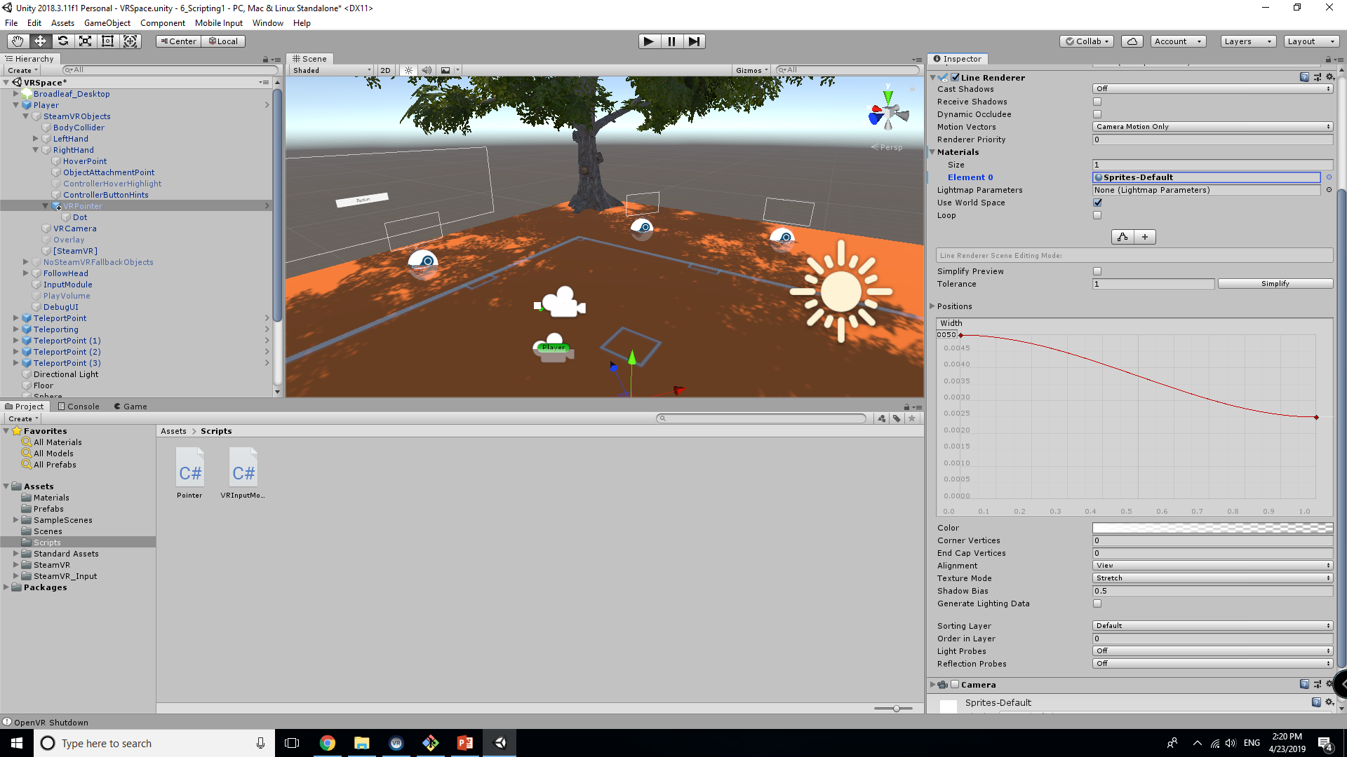
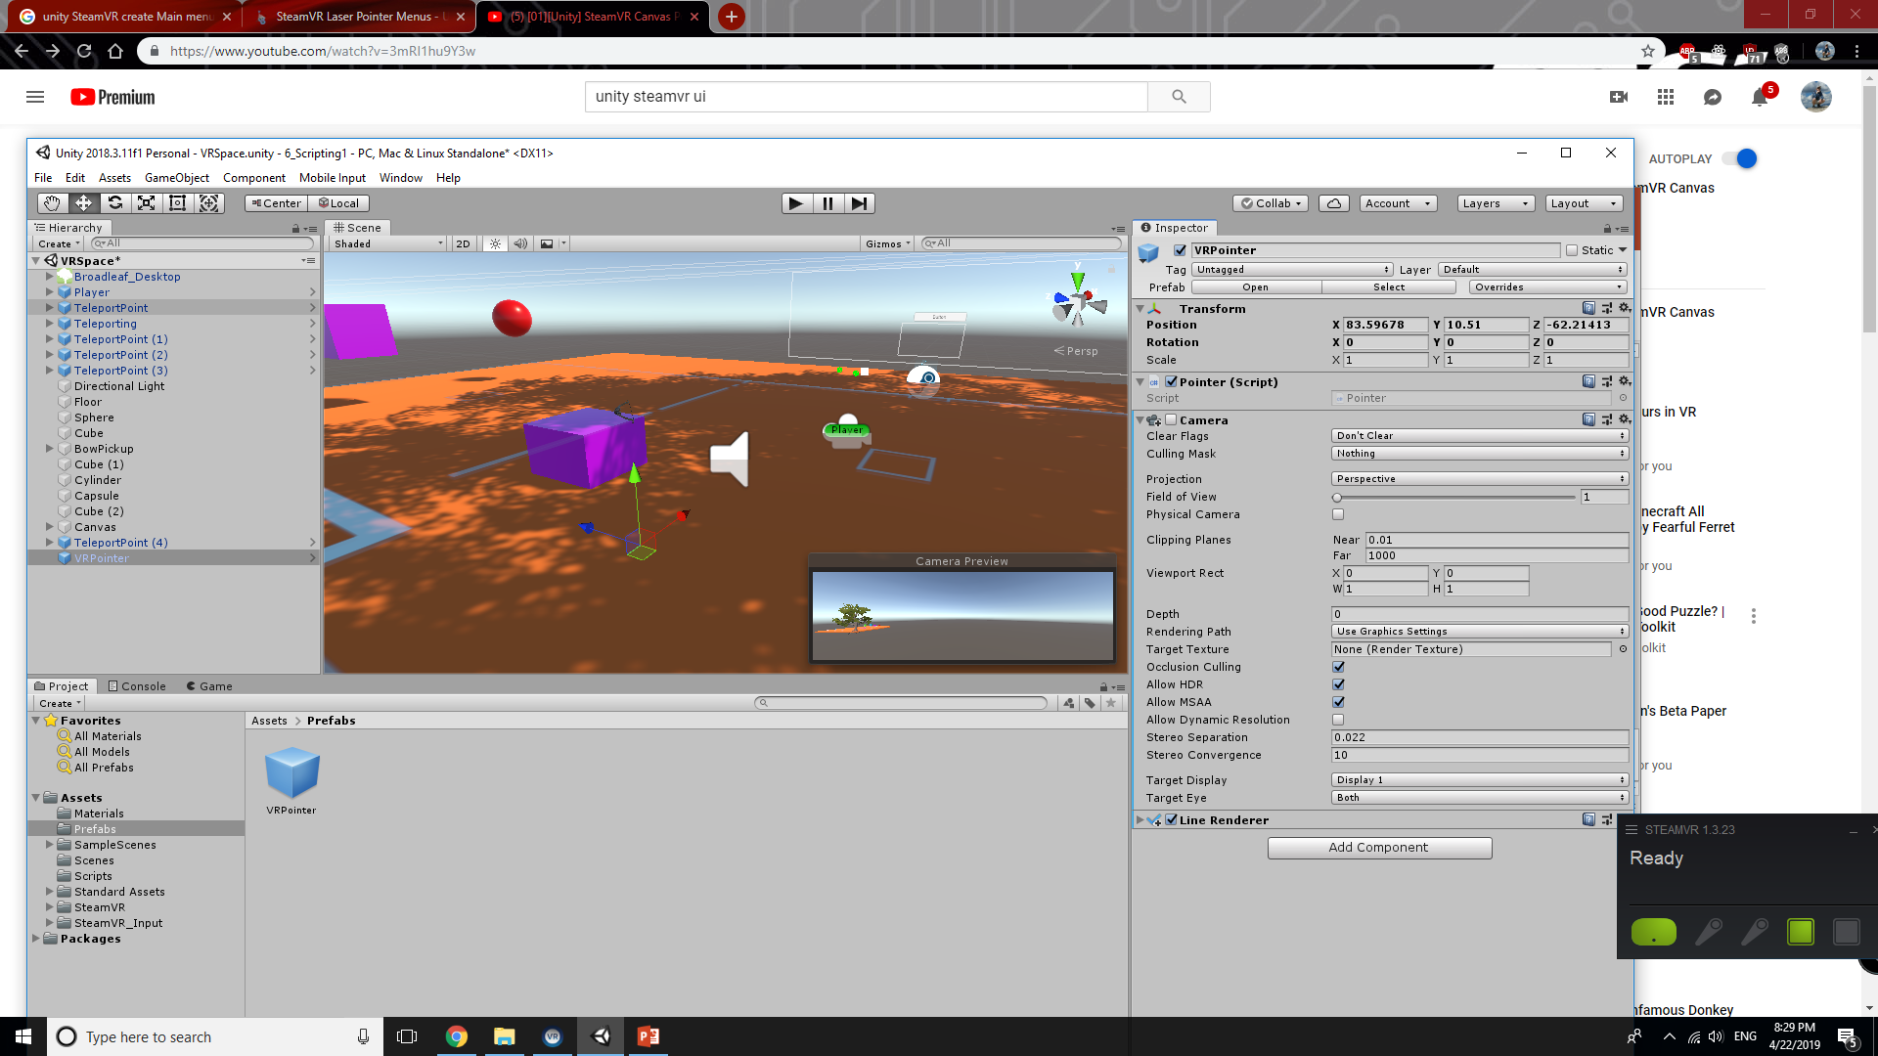
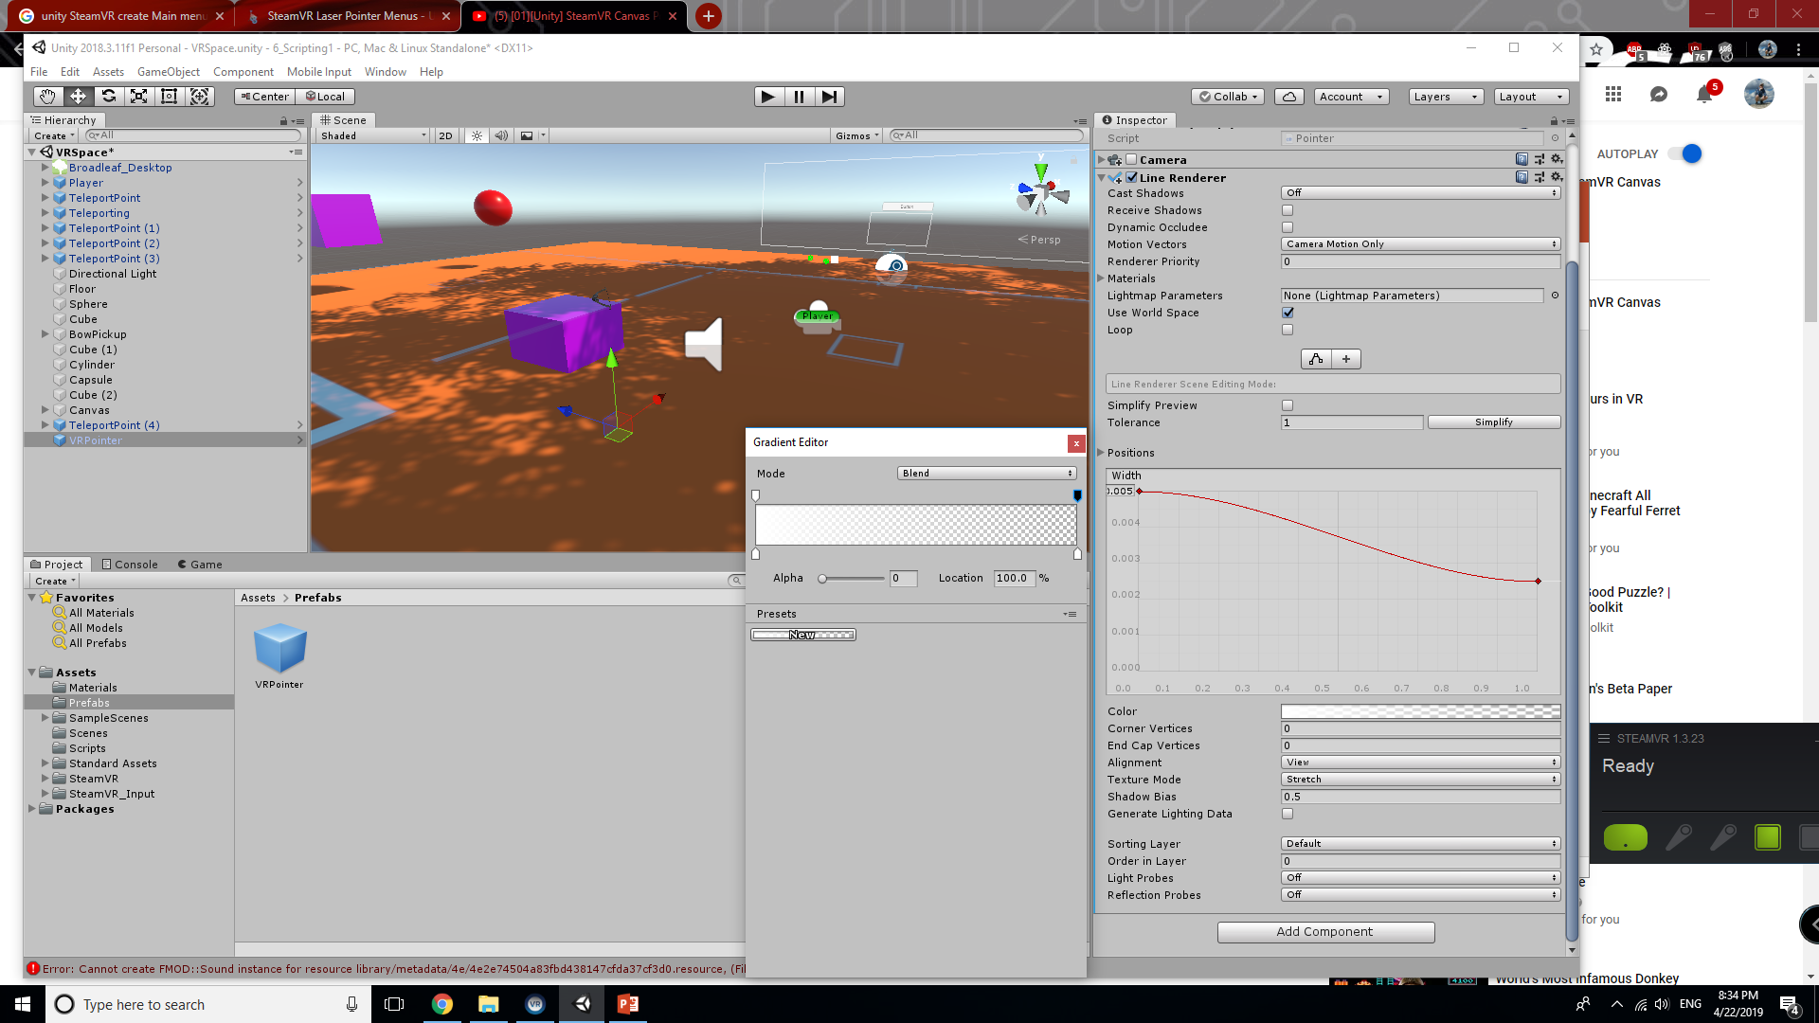

Slide 10
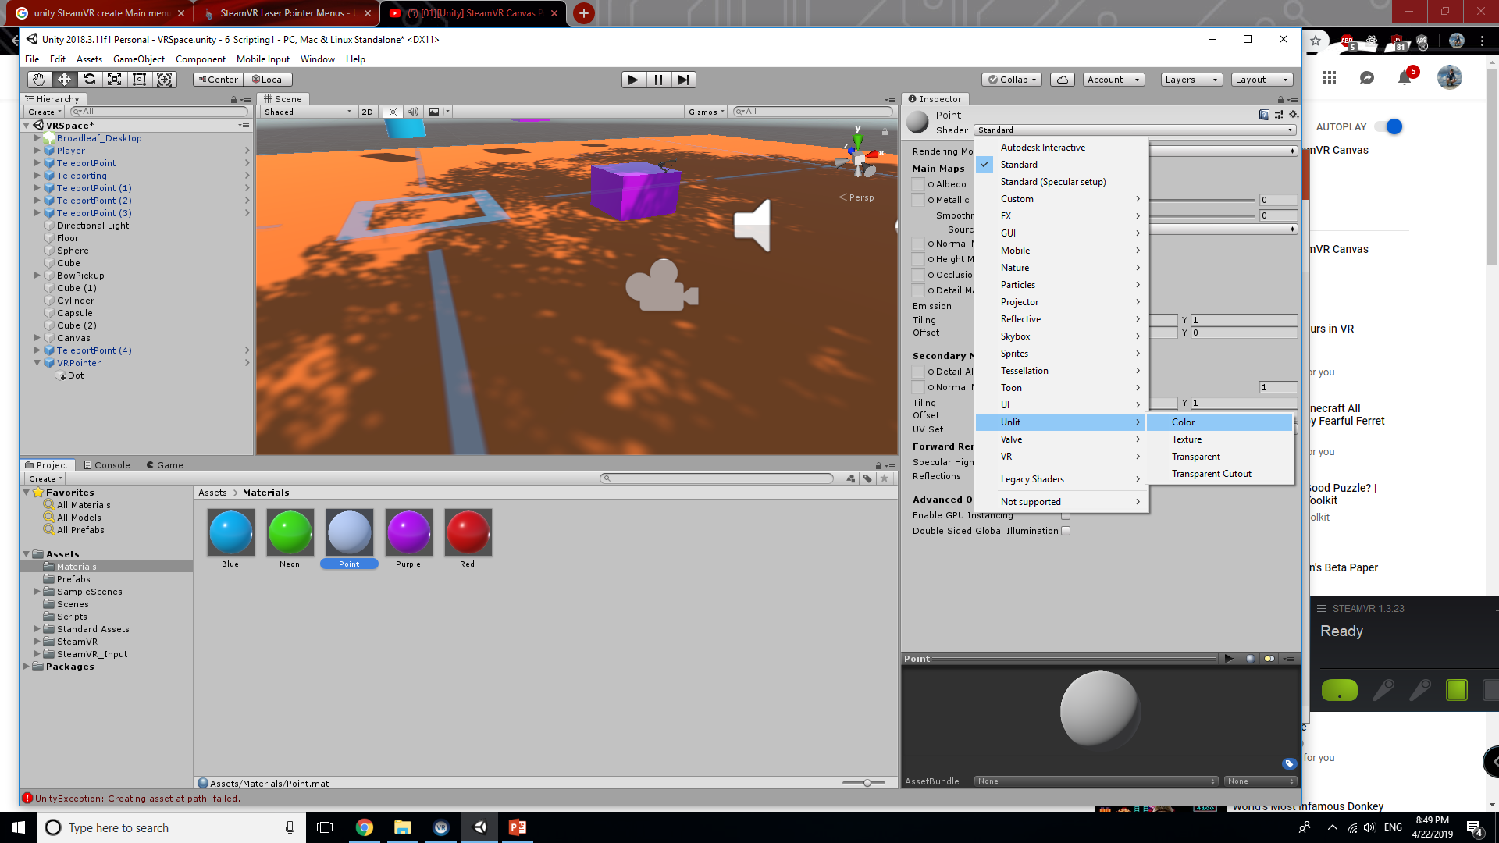
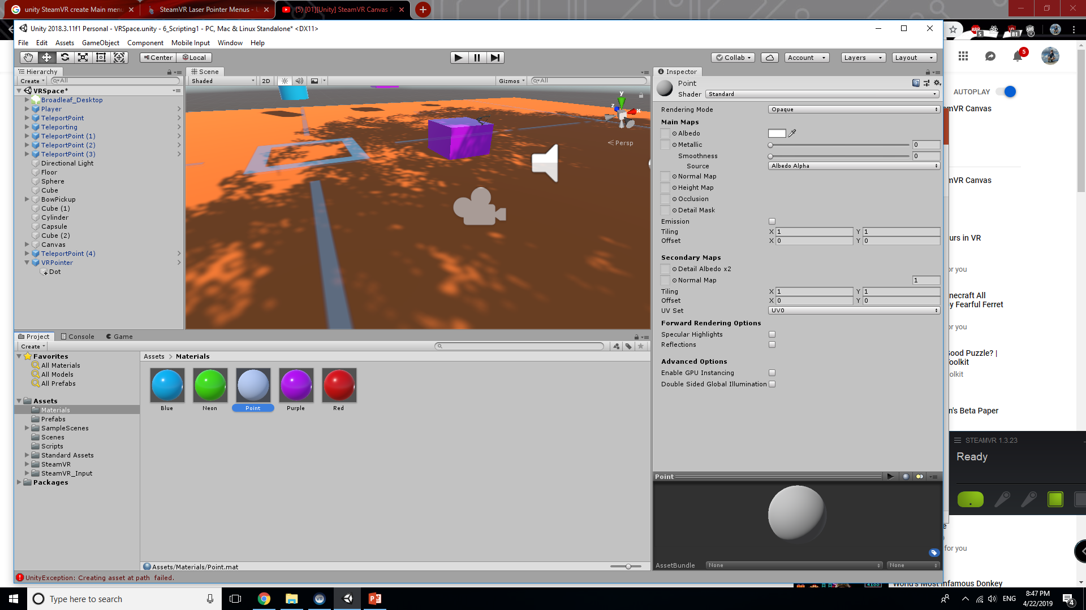
Creating a Point
We need to add a point at the end of the line to more clearly define what the player will point at. Start by adding a 3D Object > Sphere to the VRPointer called “Dot”
Be sure to remove the Collider from the Sphere!!!
Additionally, create a new Material called “Dot”. Use the shader Unlit > Color and give it a white color. Attach this to the sphere
Give it an appropriate size that is small enough to still see and recognize.

Slide 11
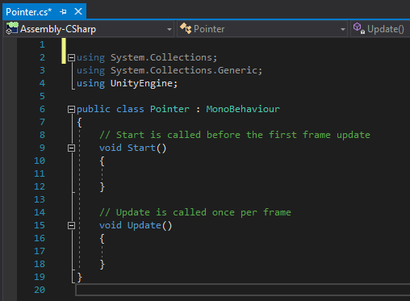
Time to Script!
We are going to start by working on the pointer script. The purpose of this script is to set up detection in our menus that we are currently pointing at a specific UI element.
We will be dynamically detecting length away from the button and will be able to detect and return a hit with the script
Start by going to the pointer script and double clicking. Visual Studio, the default editor for Unity, should open.

Slide 12
Initial Variables and Prototypes
Variables
public float m_DefaultLength = 5.0f
default length of our pointer, can be overwritten by InputModule
public GameObject m_Dot;
public VRInputModule m_InputModule;
private LineRenderer m_LineRenderer = null;
These refer to their specific object counterparts in game
Functions
private void Awake()
Initialize script, get LineRenderer ready
private void Update()
Call UpdateLine for all updates
private void UpdateLine()
Determine length, detect for hits, adjust position based on calculations
private RaycastHit CreateRaycast(float length)
Gets information on object the ray comes in contact with

Slide 13
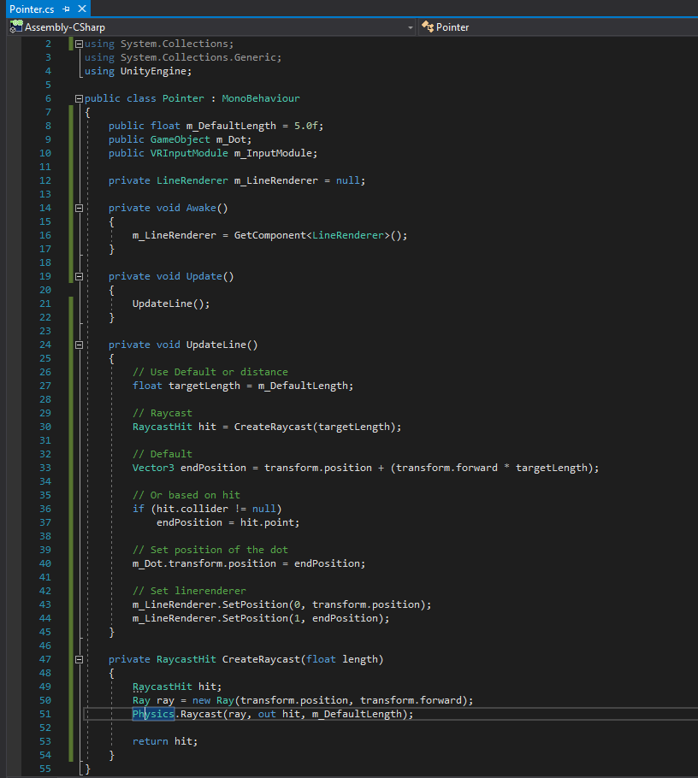
Pointer Script
The end result should look as it does on the right. Below you will find documentation on the various Types used in the script.
Functions:
RaycastHit
Ray
Physics
Explanations:
What are Raycasters
We will be focusing on using Graphic Raycasters for this tutorial

Slide 14
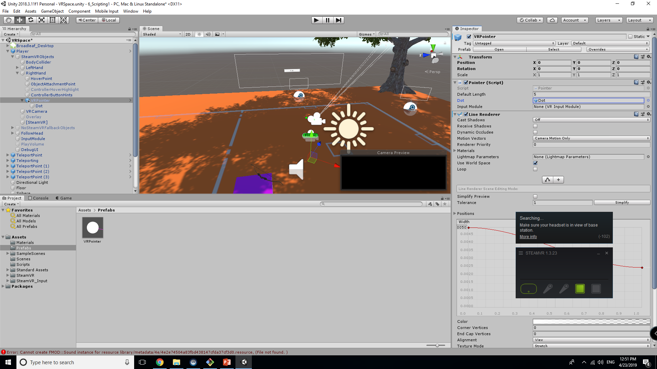
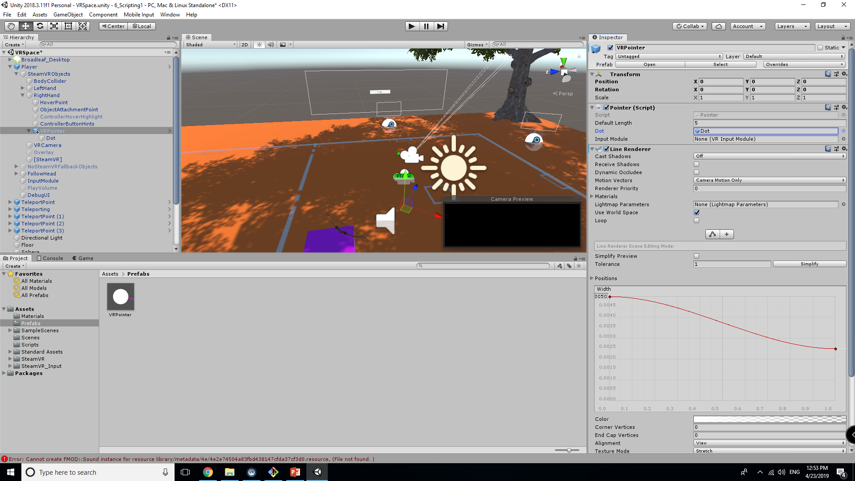
Last Touches / Notes
At this point in your inspector panel, under the Pointer script, Drag and drop the Dot object we created for VRPointer into the dot field.
Update your prefab in assets by dragging the pointer from the scene back into prefabs so you can reuse if you wish.
The VRPointer is to be dragged and dropped onto either the left or right hand. We will implement functionality to use both later.
NOTE: Set the position of the VRPointer to position (0, 0, 0) AFTER you attach it to the Right/LeftHand

Slide 15
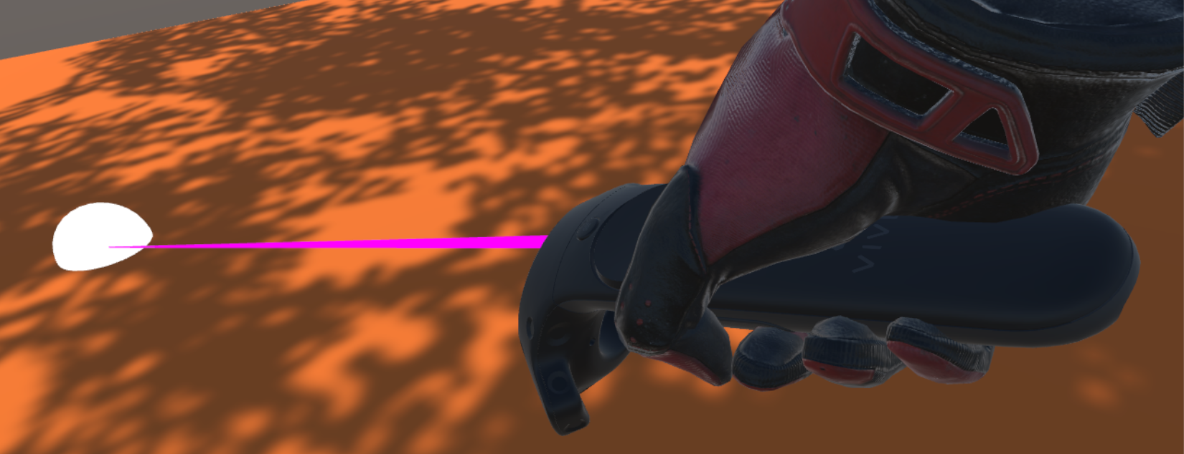
The Result
*Your line should default to white

Slide 16
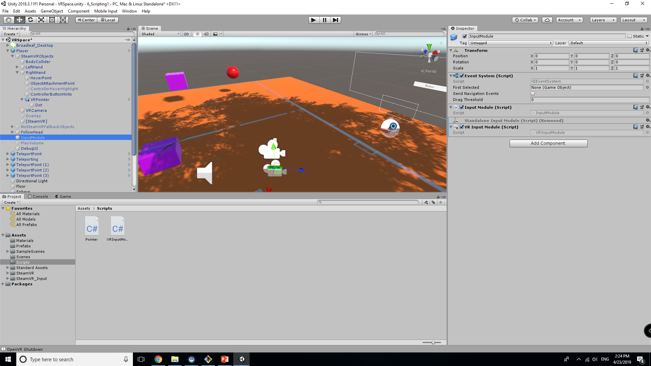

InputModule
This is an EventSystem that will handle all interactions the player has. We will be modifying the default one included in the SteamVR Player Controller Prefab.
Start by removing the Standalone Input Module and Attaching the VR Input Module Script we created.
Note that by doing this, we cannot save it as a prefab without breaking the player prefab. Do this if you like, just understand what this means

Slide 17
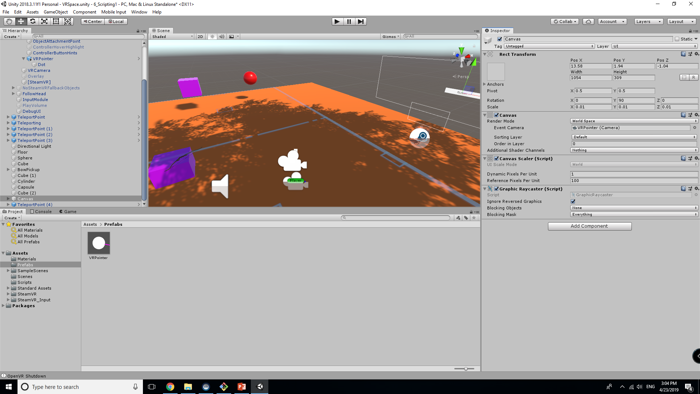
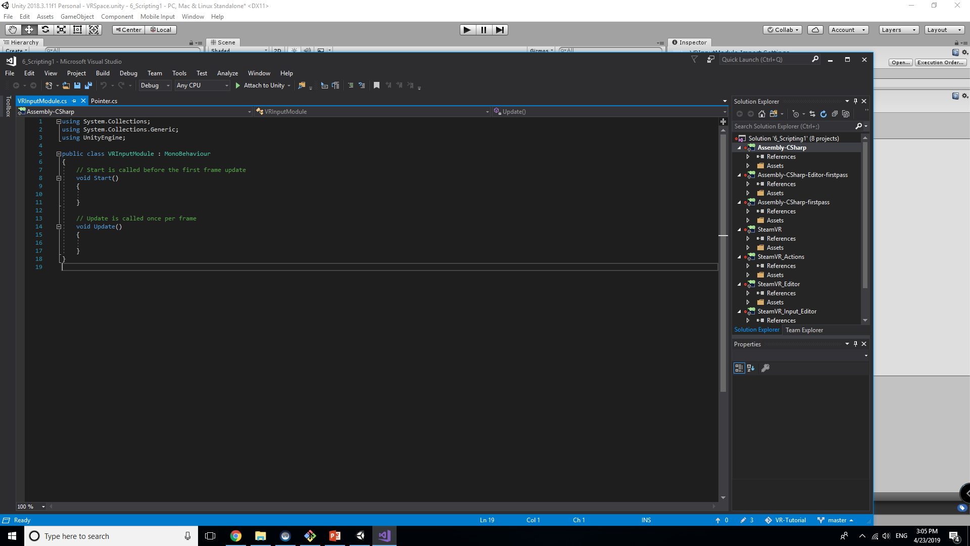
More Preliminary Setup
We need to attach the VRPointer (Camera) to the Canvas to ensure that the scene is ready for the script. Once this is done, go ahead and open the VRInputModule Script.

Slide 18
Initial Variables and Prototypes
Variables
Public:
m_Camera, m_TargetSource, m_ClickAction
GameObjects and Input to be accessed in script
Private:
m_CurrentObject, m_Data
Used to track data for the inputs
Functions
Protected override void Awake()
Set pointer
Public override void Process()
Handle all pointer interactions
public PointerEventData GetData()
Update distance
private void ProcessPress(PointerEventData data)
private void ProcessRelease(PointerEventData data)
Handles press and release of button, we will return to this later

Slide 19
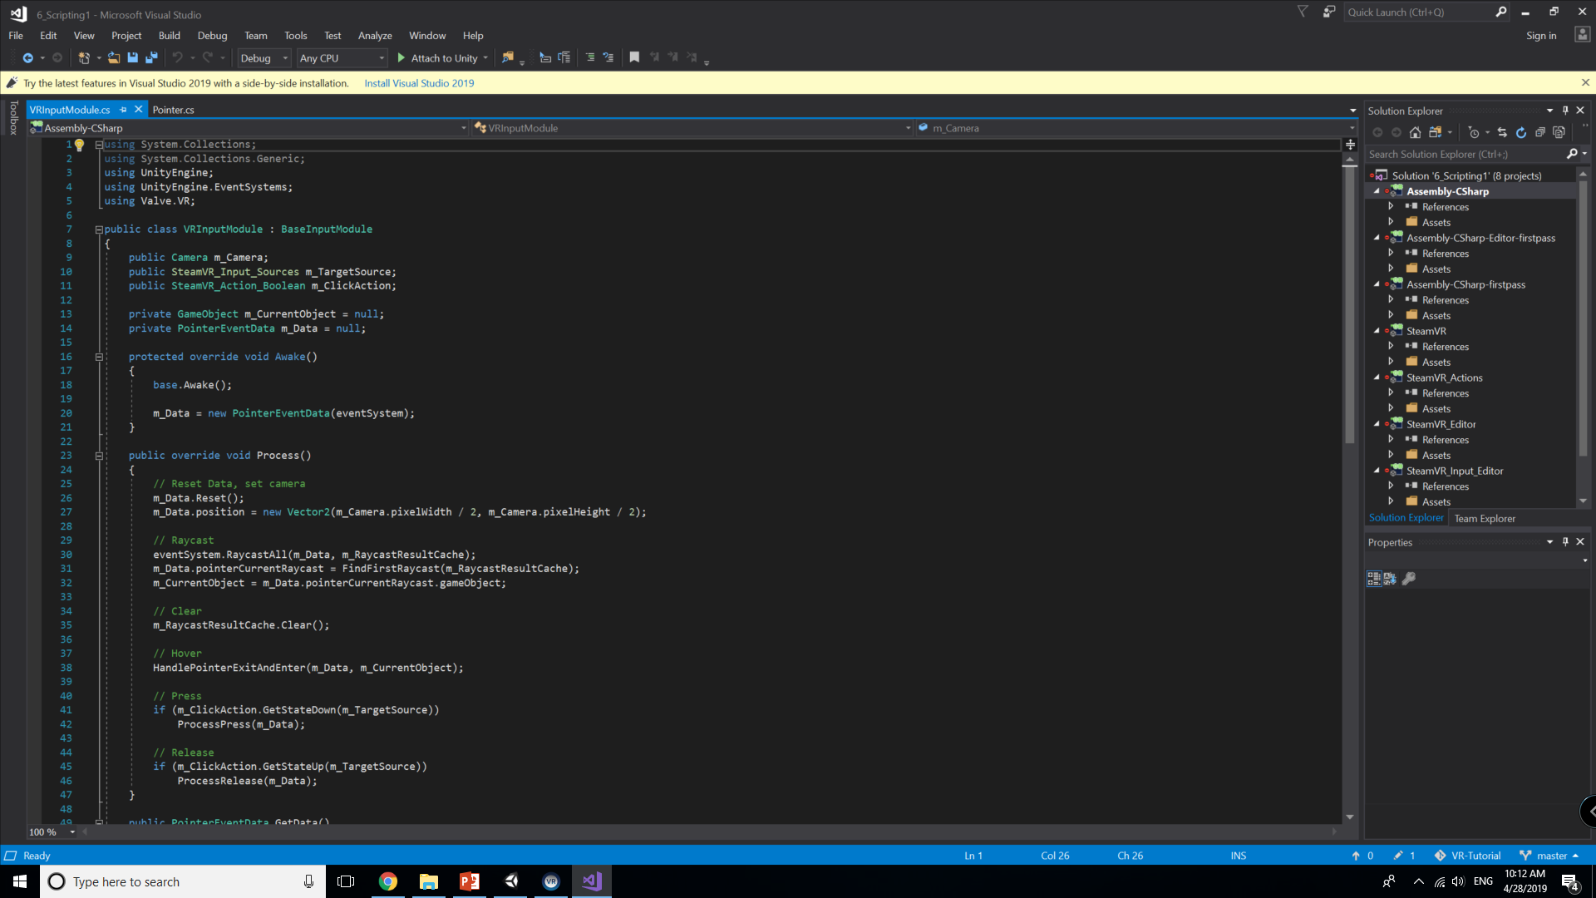
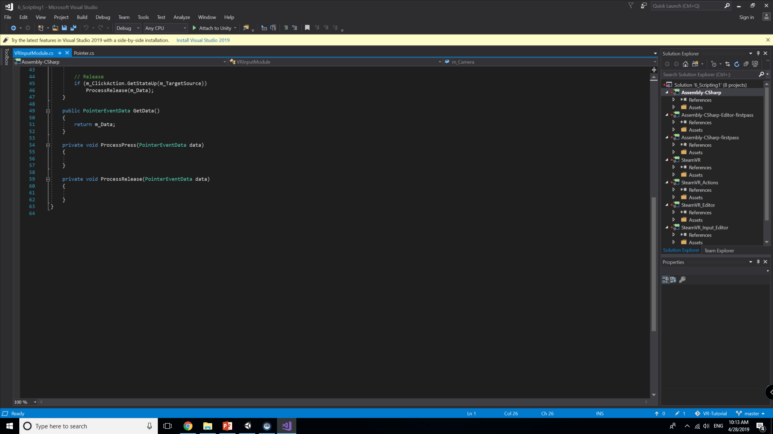

Slide 20
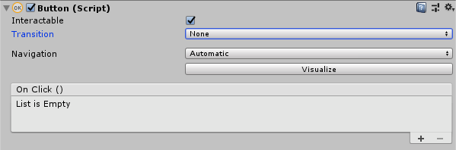
Handling UI Color Script
Our button(s) currently have a standard Unity script attached to them, but we are going to create another script to somewhat override parts of its functionality.
Go ahead and make these adjustments to each of the buttons you have on your canvas
We will also be making another script called ButtonTansitioner

Slide 21
Initial Variables and Prototypes
Variables
Public:
Color32 m_NormalColor;
Color32 m_HoverColor;
Color32 m_DownColor;
Colors to be used based on events
Private:
Image m_Image;
Functions
Private void Awake()
Gets our buttons
Public void OnPointerEnter, OnPointerExit, OnPointerDown, OnPointerUp, OnPointerClick
Events used to determine interactions
Once script is written, drag and drop it onto your buttons

Slide 22
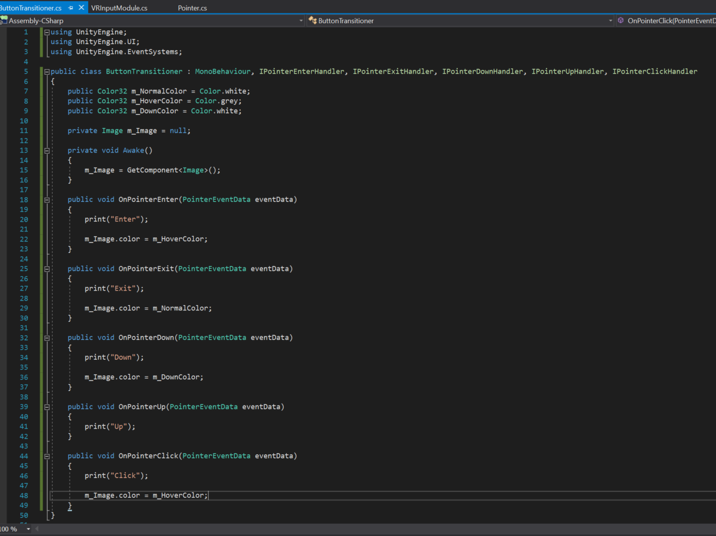

Slide 23
Return to VRInputModule
We are going to flesh out the functionality of the clicks
Additionally with these in place, we also need to modify the pointer script to use distance from the object to properly have the dot land on each object

Slide 24
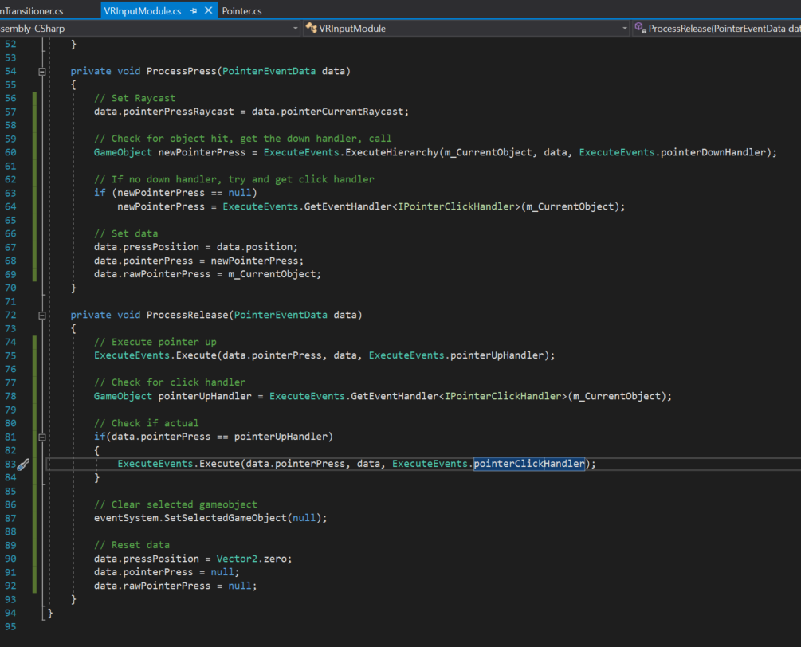
VRInputModule
The functionality here is set to get gameobject data and connect to the respective events each button has.
We will in a later tutorial create functionality specific to each button.
For now we are laying out the framework.

Slide 25
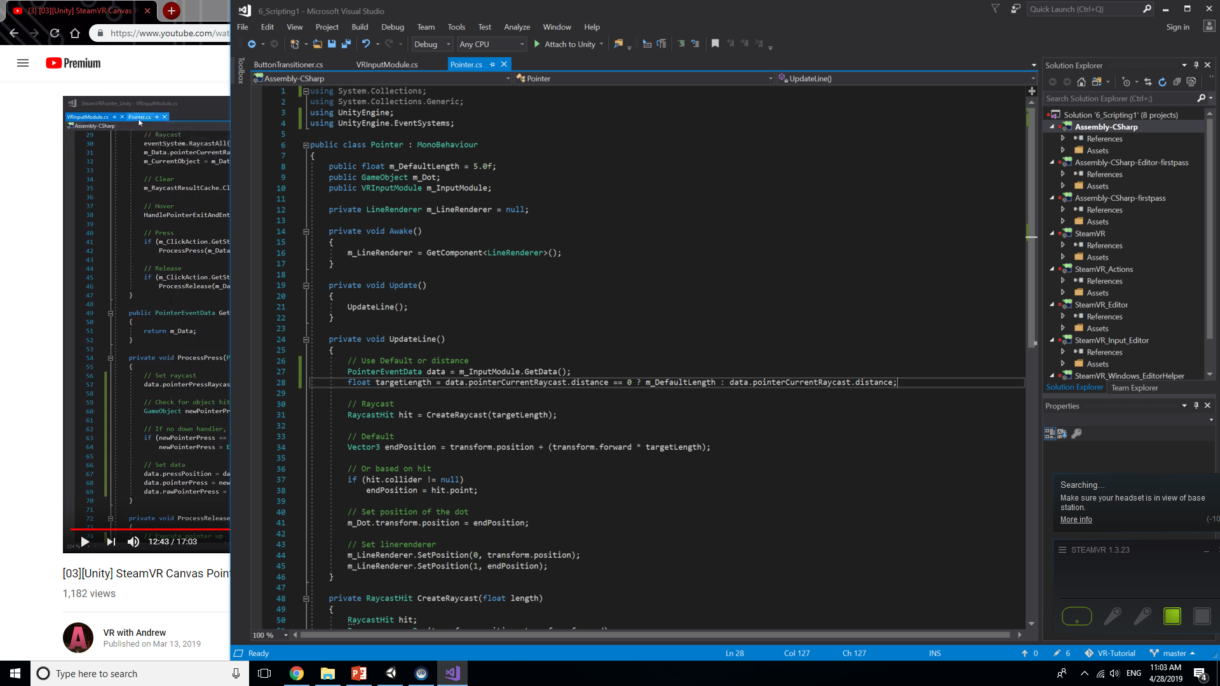
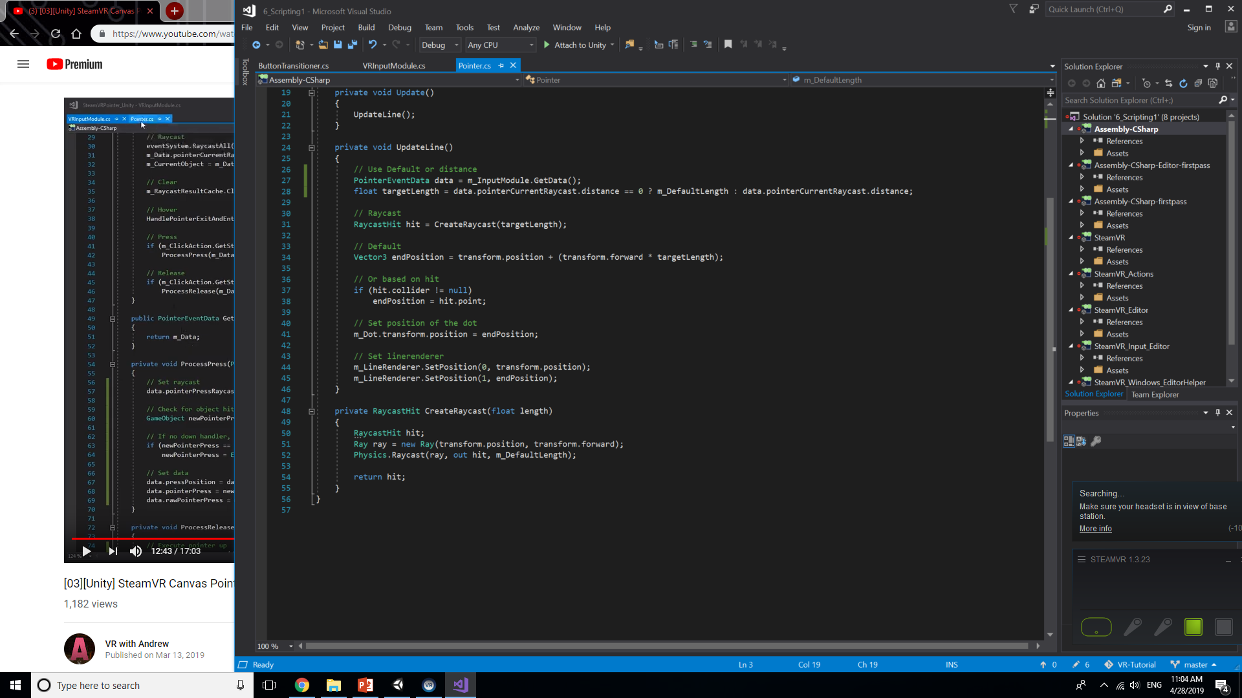
Pointer
These are the small additions necessary for this script.
Make sure these lines are added so the dot may properly align to the face of the UI.

Slide 26
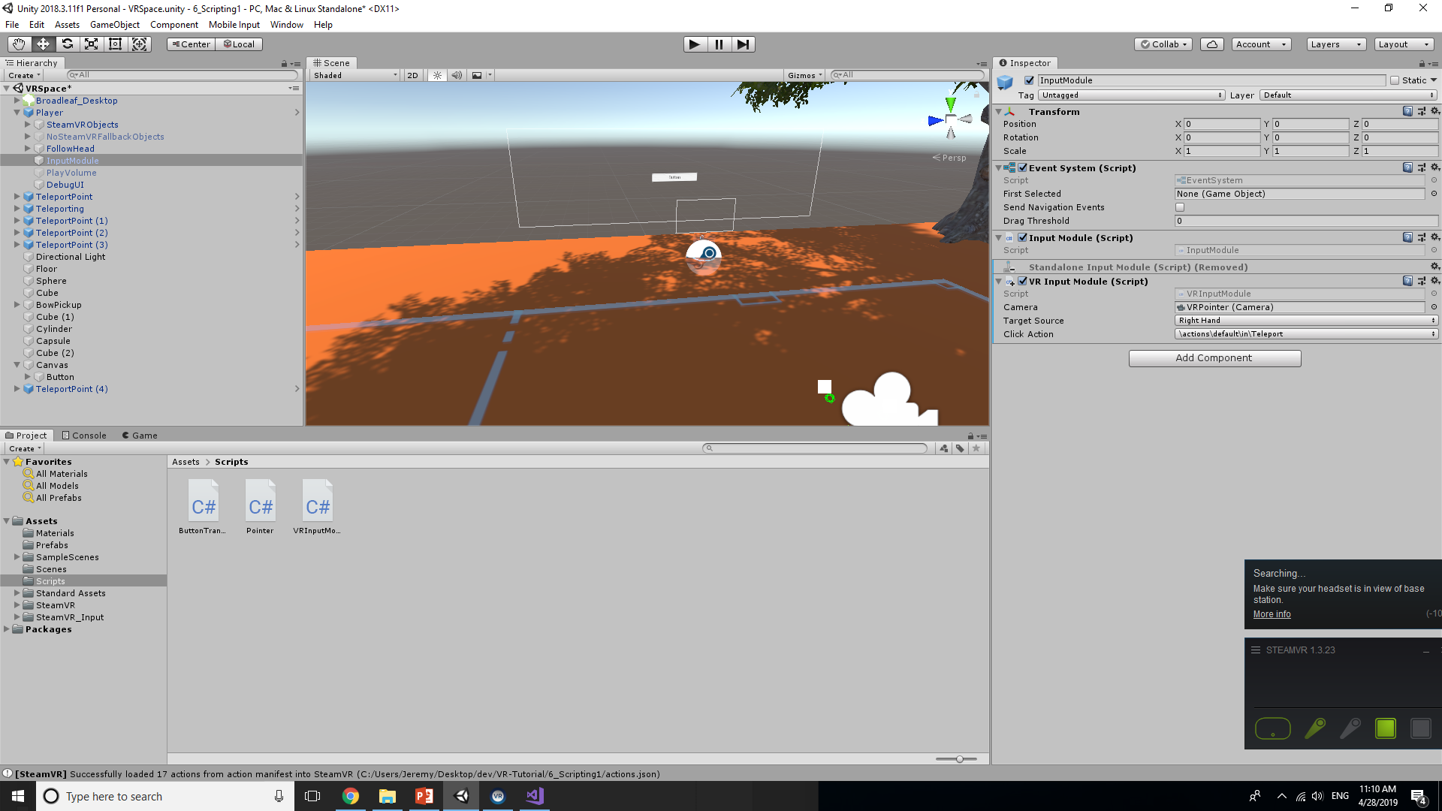
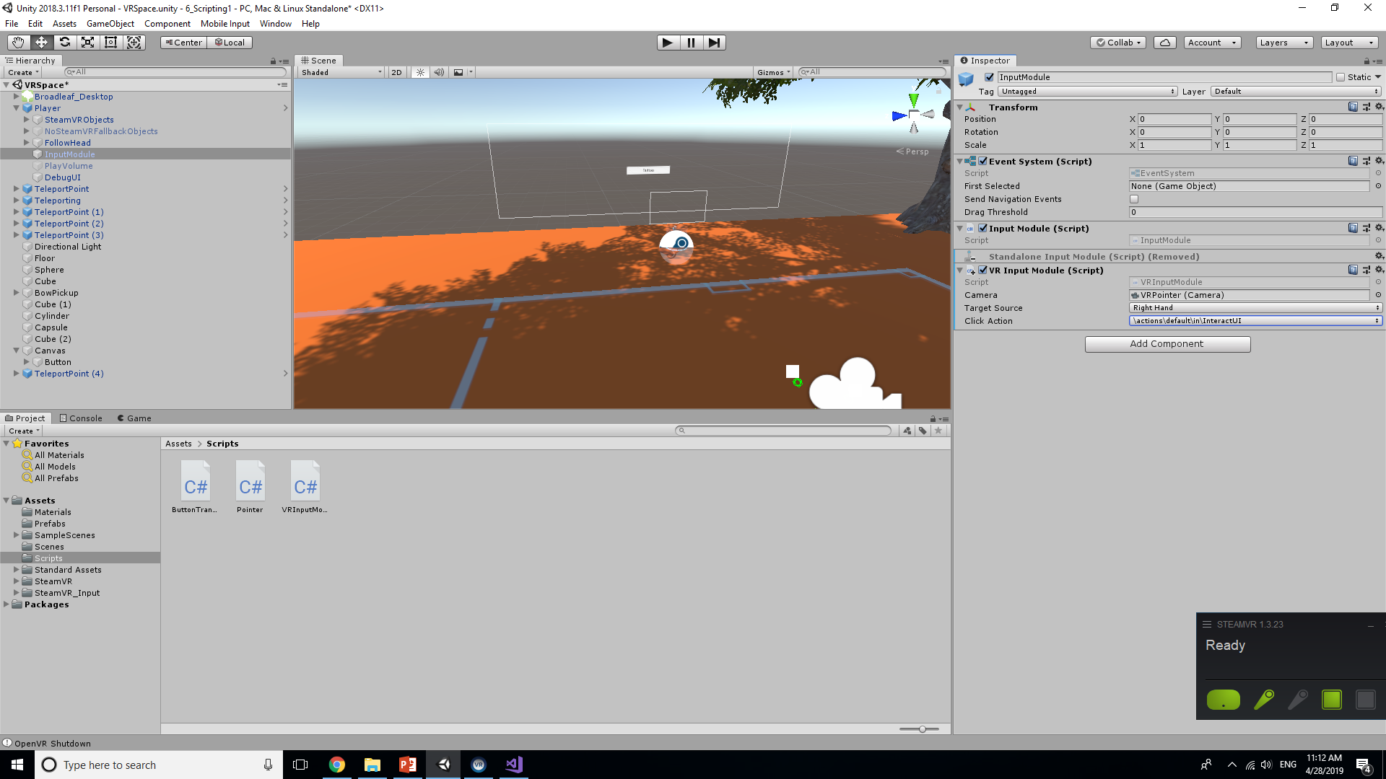
Final Note
In the inspector panel of the input module attached to your player object, make sure that the Click action is tied to Interact with UI. This should be the default action for trigger clicks

Slide 27
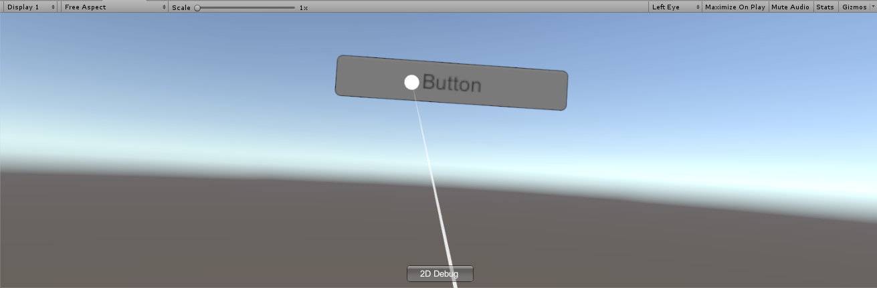
Result
You should now be able to ingame highlight, click, and release on UI buttons.

Slide 28
Looking Ahead
In part 2, we will be looking at adding functions to the buttons to handle what they specifically do to set the stage to create a minigame

